Slide 1
THAI TEXT EMOTION DETECTION
Machine Learning Final Project

Slide 2



OUR TEAM
64011363
64011380
64011551
Chalermwut
Jutanit
Chonlaphat Ingkharratphithakon
Phraechanok
Rimdisit

Slide 3
TABLE OF CONTENT
01
02
03
Objective
Process
Library Used
07
Application
04
05
06
Data
Model
Result
Page 3-4
Page 5-6
Page 7-10
Page 21-22
Page 11-13
Page 14-16
Page 17-20

Slide 4
01
OBJECTIVE

Slide 5

Objectives
Further analysis in other related field such as marketing
For understanding emotion in thai language

Slide 6
02
PROCESS

Slide 7
PROCESS
IMPORT DATA
PREPROCESS DATA
STEP 1
STEP 2
STEP 3
STEP 4
STEP 5
CREATE DATA
EXPLORE DATA
CREATE MODEL
Notes:
We start off with gathering data from x.com and ask our friend on their opinion in each sentence
The we import data using github, so every could access to the data
Explore data look for missing value
In preprocess, we did tokenization => change emoji to thai words using stopword from HAINLP lib
Then we finally creates the model using Multinomial NB and Logistic regression

Slide 8
PROCESS
STEP 1
We create the data by gathering data from x.com
Ask an opinion on our friends in each sentence
CREATE DATA
0 = SAD
1 = JOY AND HAPPINESS
2 = LOVE
3 = ANGER
4 = FEAR
5 = SURPRISE
Notes:
We start off with gathering data from x.com and ask our friend on their opinion in each sentence
The we import data using github, so every could access to the data
Explore data look for missing value
In preprocess, we did tokenization => change emoji to thai words using stopword from HAINLP lib
Then we finally creates the model using Multinomial NB and Logistic regression

Slide 9
PROCESS
IMPORT
Save excel as csv.
Export the saved file to Github.
Use google collab to import the saved data from Github.
IMPORT DATA
STEP 2

Slide 10
PROCESS
EXPLORE
Check for error and missing values.
Check data size.
STEP 3
EXPLORE DATA

Slide 11
PROCESS
PREPROCESS
Import PYTHAINLP library.
Change emoji to thai words using stopword from THAINLP library.
Tokenize thai words - to move all the emoji to the back and eliminating the meaningless word as well as split data into words.
PREPROCESS DATA
STEP 4

Slide 12
PROCESS
MODEL
Use countvectorizer to create bag of words for Multinomial NB and Logistic Model.
Use TF-IDF for Logistic regression.
Make Multinomial NB and Logistic Model.
STEP 5
CREATE MODEL

Slide 13
03
LIBRARY USED

Slide 14



LIBRARY USED
SKLEARN
PYTHAINLP
PANDAS
Provides simple and efficient tools for data analysis and modeling.
Library used for tokenizing thai language.
Library used for creating DataFrames for training set.

Slide 15



LIBRARY USED
MATPLOTLIB
YELLOWBRICK
NUMPY
Library built on top of Matplotlib design to enhance ML model
Library used for numerical computing in a large multi-dimensional arrays
Helps generate plots and charts for the model.
Notes:
Yellowbrick is a Python library built on top of Matplotlib and Scikit-learn, designed to enhance machine learning model evaluation and visualization by providing a simple and consistent API for various visual diagnostic tools.

Slide 16


LIBRARY USED
STREAMLIT
JOBLIB
Used to save model to cloud
Allows developers to turn data scripts into shareable web apps with minimal code.

Slide 17
04
DATA
DATA from X.com

Slide 18
DATA
DATA DESCRIPTION
0 = SAD
1 = JOY AND HAPPINESS
2 = LOVE
3 = ANGER
4 = FEAR
5 = SURPRISE

Slide 19
DATA
CRITERIA
The data we are choosing is a Data in X.com which is the most frequent community in Thai needs and young adults to comment their thought on which has a unique slag and language
Hashtag - we select hashtag according to our target such as #เศร้า #รัก and a trendy hashtag such as #อุงเอิง #โยเกิร์ต #พีเค
The period of gathering is a recent 2-3 weeks (25 Feb-6 Mar) (for an update data - as a new slay is always created)
There are 315 rows of data with 6 columns
We manually label the opinion on each sentence emotion expression by asking our friend to comment on the opinion.
Notes:
We start off with gathering data from x.com and ask our friend on their opinion in each sentence
The we import data using github, so every could access to the data
Explore data look for missing value
In preprocess, we did tokenization => change emoji to thai words using stopword from HAINLP lib
Then we finally creates the model using Multinomial NB and Logistic regression

Slide 20
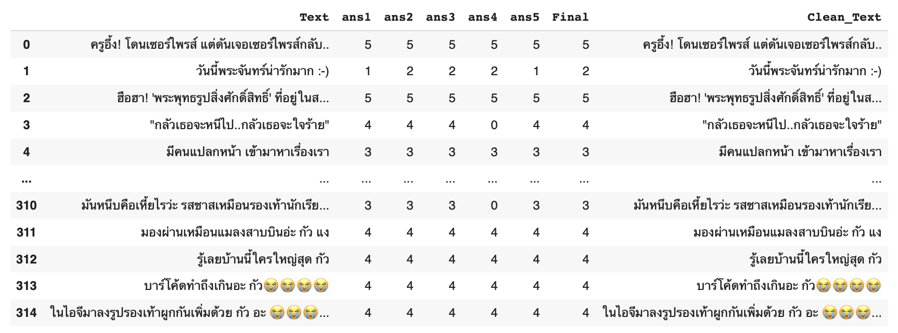
DATA from X.com

Slide 21


WHY THAI TEXT
Thai sentence is not straightforward
Notes:
In thai sentence sometimes people word do not really match with what they want to express. We have to look at the sentence structure as well. unlike english word, the meaning is very straight forward.

Slide 22
05
MODEL

Slide 23
Testing and Training dataset
We would like to training the dataset as much as possible so we set the training dataset to be 80% with shuffle and stratify the dataset

Slide 24
MODELS
Multinomial NB
Logistic Regression
There are many category output not as binomial and calculate from probability with no requirement of features
It is classification that can find probability and can do multinomial with no requirement of feature.
Notes:
We use multinomial NB and Logistic regression as we would like to categorize the data into classes aka (classification). Since our data is a text which has no feature, so we select these 2 models because, the model grouping the data using probability while other model such as KNN, DT are involving feature in the gruopping data
Indeed, multinomial NB, we find probability of each word in the text => Multi(because have more than 2 target => 0,5)
Logistic regression => we find probability of each word and multinomial
We then do both to compare.

Slide 25
MODELS
Multinomial NB
Step:
We tokenized the data using THAINLP library
Splitting data into testing and training dataset
Using countvectorizer to count the frequency of the words
Then create the model.
There are many category output not as binomial.
Notes:
We use multinomial NB and Logistic regression as we would like to categorize the data into classes aka (classification). Since our data is a text which has no feature, so we select these 2 models because, the model grouping the data using probability while other model such as KNN, DT are involving feature in the gruopping data
Indeed, multinomial NB, we find probability of each word in the text => Multi(because have more than 2 target => 0,5)
Logistic regression => we find probability of each word and multinomial
We then do both to compare.

Slide 26
Why use multinomial NB instead of other classification model?
Multinomial NB could handle the multiple class classification since there are 6 targets in our model
0 = SAD
1 = JOY AND HAPPINESS
2 = LOVE
3 = ANGER
4 = FEAR
5 = SURPRISE

Slide 27
MODELS
Logistic Regression
Step:
We tokenized the data using THAINLP library
Splitting data into testing and training dataset
Using countvectorizer to count the frequency of the words
Use TF-IDF to eliminate the frequent word appeared
Then create the model.
It is classification that can find probability and can do multinomial.
Notes:
We use multinomial NB and Logistic regression as we would like to categorize the data into classes aka (classification). Since our data is a text which has no feature, so we select these 2 models because, the model grouping the data using probability while other model such as KNN, DT are involving feature in the gruopping data
Indeed, multinomial NB, we find probability of each word in the text => Multi(because have more than 2 target => 0,5)
Logistic regression => we find probability of each word and multinomial
We then do both to compare.

Slide 28
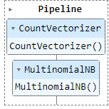
PIPELINE
Automate the ML workflow
Analyze the complexity of language without caring the coefficient
Allow the creator to focus on the updated data only
Reduce Model Error
Notes:
We are using pipeline instead of manual coding as
The pipeline could automate the ML workflow as it could learn the process themselves.
As our project is dealing with the complexity of language, pipeline could handle the data without caring the straightforward meaning of each word
Since model could be used with any data, pipeline allow the user to deal with an updation of the data without worrying bout the error of coding.

Slide 29
Why using countvectorizer instead of other vectorizer?
CountVectorizer
CountVectorizer is a bag of word that we use to count the word
Basic and common use vectorizer that help the ML to better understanding the model
Notes:
We are using pipeline instead of manual coding as
The pipeline could automate the ML workflow as it could learn the process themselves.
As our project is dealing with the complexity of language, pipeline could handle the data without caring the straightforward meaning of each word
Since model could be used with any data, pipeline allow the user to deal with an updation of the data without worrying bout the error of coding.

Slide 30
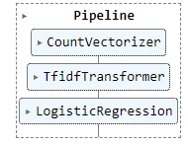
TF-IDF
We use TF-IDF function as
it eliminate the frequent word appeared
Suitable with logistic regression
Making more understanding and more accuracy in Logistic Regression
Notes:
We use multinomial NB and Logistic regression as we would like to categorize the data into classes aka (classification). Since our data is a text which has no feature, so we select these 2 models because, the model grouping the data using probability while other model such as KNN, DT are involving feature in the gruopping data
Indeed, multinomial NB, we find probability of each word in the text => Multi(because have more than 2 target => 0,5)
Logistic regression => we find probability of each word and multinomial
We then do both to compare.

Slide 31
06
RESULT

Slide 32
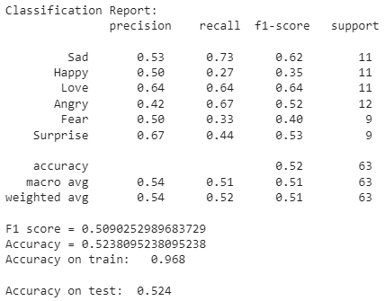
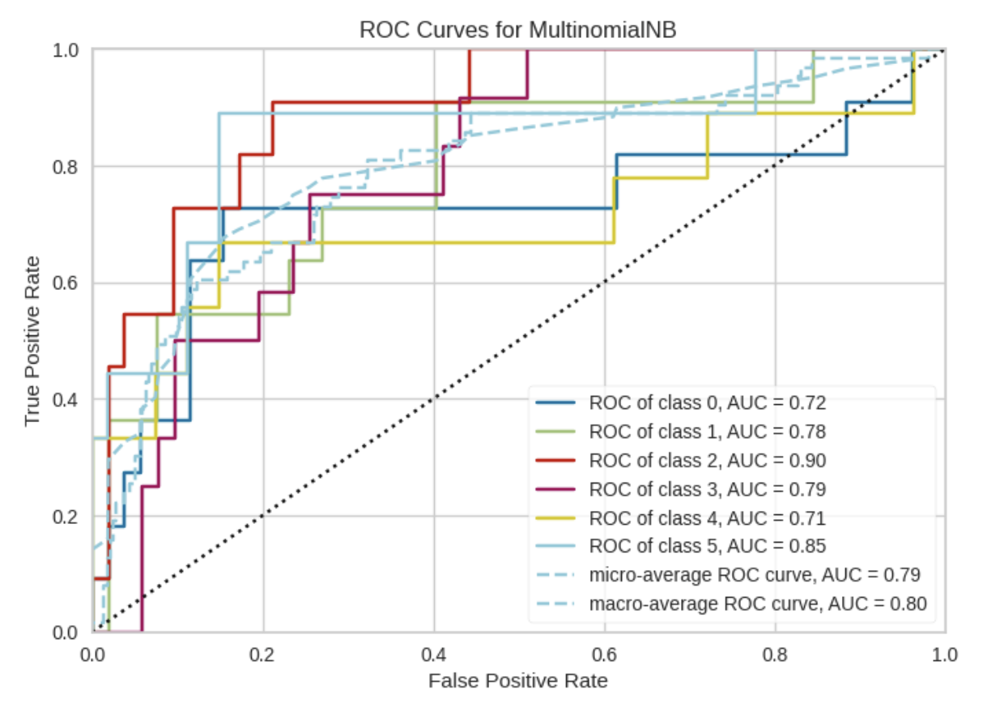
Multinomial NB

Slide 33
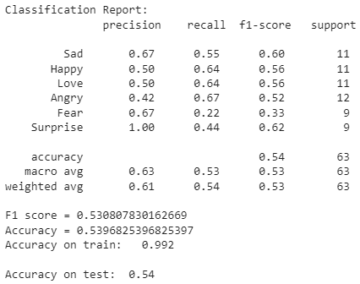
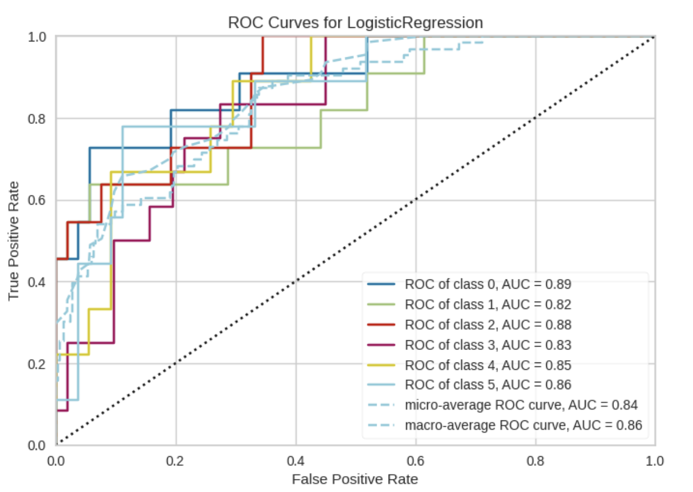
Logistic Regression

Slide 34
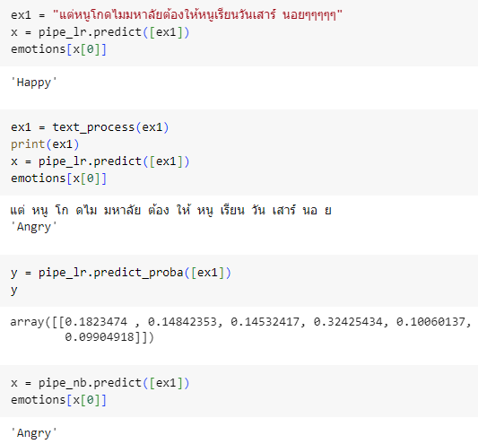
Example Testing

Slide 35
07
APPLICATION

Slide 36
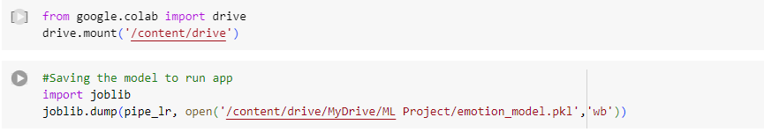
Save Model
We use save the model to
Prevent when get error and when code get disappeared
To make an app for further analyze of our model

Slide 37
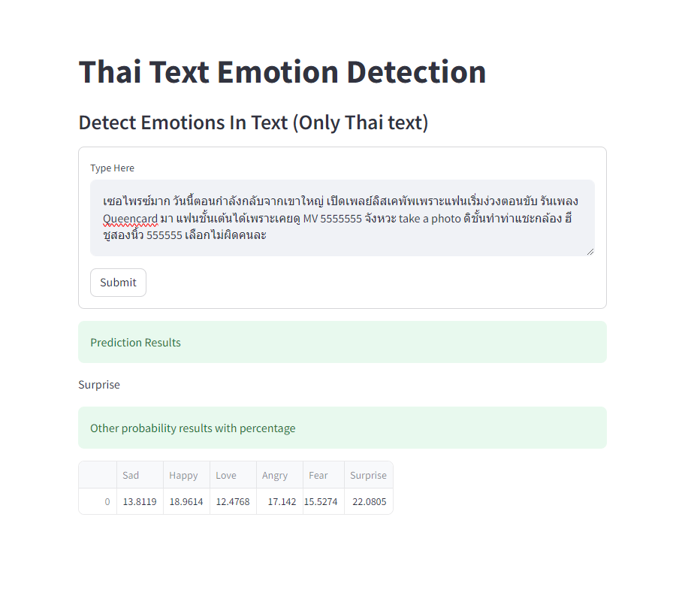
Web Application

Slide 38
CONCLUSION
“The model shows to be 50%-55% accuracy, but still acceptable”
Notes:
The model shows to be 50%-55% accuracy as there is a different in judgment of the sentence

Slide 39
IMPROVEMENT
Increase data set.
Average the type of emotion in the data set.
Notes:
The model shows to be 50%-55% accuracy as there is a different in judgment of the sentence

Slide 40
THANK YOU

